Slide 1
IMPATTO DELLA CHIRURGIA BARIATRICA SULLA FERTILITÀ
Prof. Monica Nannipieri
Dpt. Medicina Clinica e Sperimentale
Università di Pisa

Slide 2
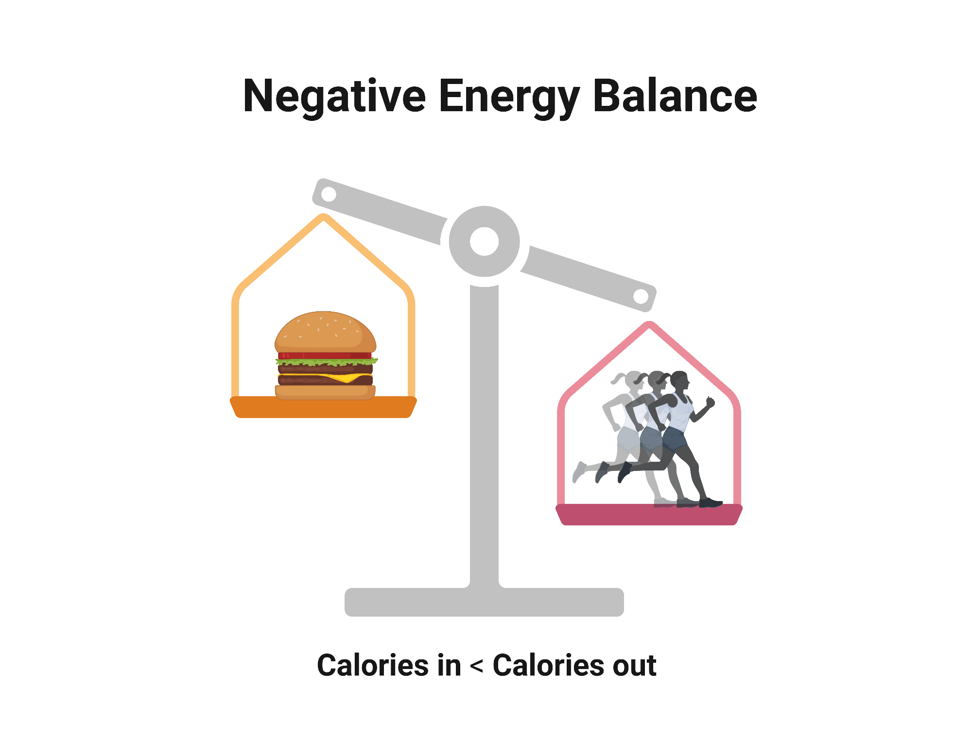
Pathophysiological mechanisms of low testosterone and secondary hypogonadism in obese men
Escobar-Morreales HF, Human Reproduction Update 2017
Notes:
This interplay may be the result of a vicious circle represented by the arrows: androgen deficiency decreases lean and muscle mass thereby increasing the relative amount of visceral adipose tissue, and visceral fat facilitates androgen deficiency by inhibiting gonadotropin secretion at the hypothalamic–pituitary level through the combined action of increased aromatase activity and estrogen generation and increased secretion of inflammatory cytokines in visceral fat, and through the induction of insulin resistance.

Slide 3
Pathophysiological mechanisms of low testosterone and secondary hypogonadism in obese men caused by fat mass and aggravated by endocrine-disrupting chemicals (EDCs)
Magalhaes DP, Human Reproduction 2022

Slide 4
Pre- and post-bariatric surgery processes involved in male reproductive functioning
Testosterone levels comparing before and after surgery.
Erectile dysfunction comparing before and after surgery.
Małczak P, Obesity Surgery 2023

Slide 5
Pre- and post-bariatric surgery processes involved in male reproductive functioning
Males

Slide 6
Pre- and post-bariatric surgery processes involved in male reproductive functioning
EDCs: endocrine-disrupting chemicals
Magalhaes DP, Human Reproduction 2022

Slide 7
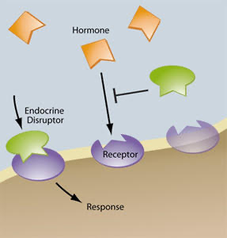
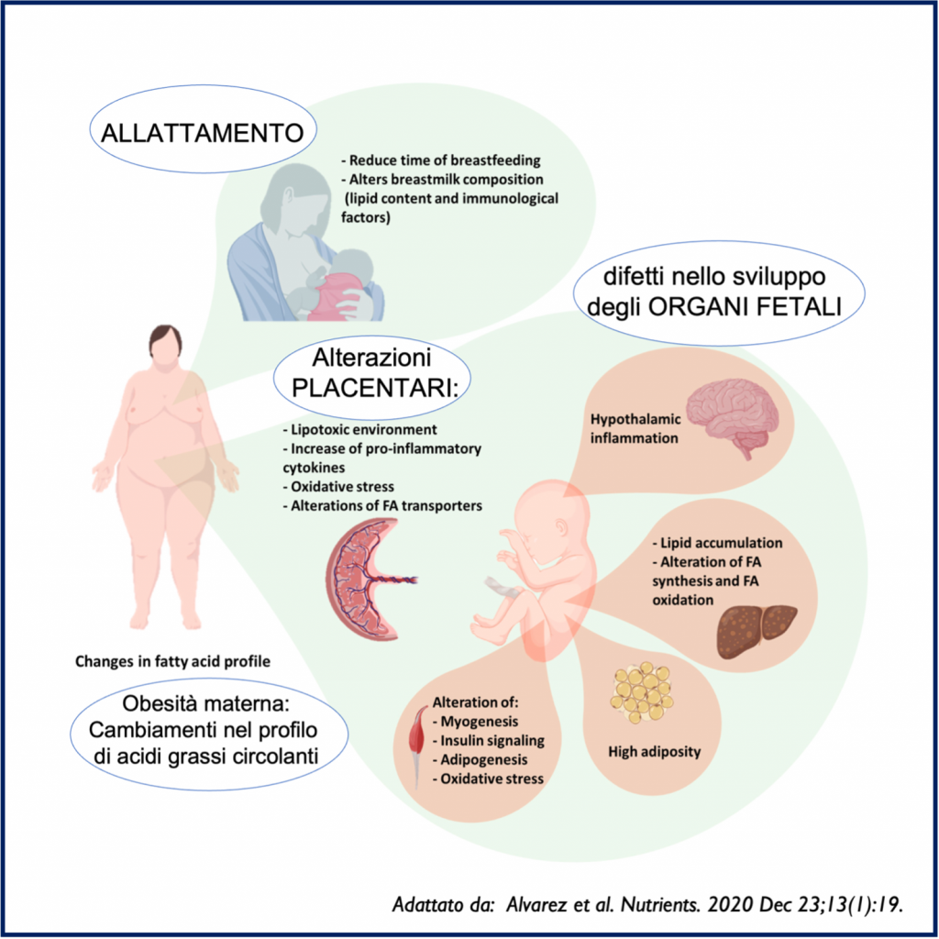
Obesity and Infertility
Escobar-Morreales HF, Human Reproduction Update 2017
Notes:
The interplay between PCOS and abdominal adiposity may be the result of a vicious circle represented by the black arrows: androgen excess favors the abdominal deposition of body fat, and visceral fat facilitates androgen excess of ovarian and/or adrenal origin by the direct ef

Slide 8
Effect of weight loss surgery on menstrual abnormalities
Small sample size studies revealed that pregnancy rates ranged from 95.2% to 100% postoperatively.
Effect of weight loss surgery on free testosterone levels in females
Chen N, Asian Journal of Surgery 2024
Yue W, Frontiers in Endocrinology 2022

Slide 9
Effects of bariatric surgery on outcomes of fertility
Females
Al Qurashi AA, Annals of Medicine and Surgery 80 (2022)

Slide 10
Potential changes in the pathophysiology of PCOS following bariatric surgery.
2
3
1
4
VSG, vertical sleeve gastrectomy; SHBG, sex hormone binding globulin; AMH, anti-mullerian hormone.
Samarasinghe SNS, Metabolism 151 (2024)

Slide 11
Relevance of obesity-associated gonadal dysfunctions for the clinical management of severe obesity in men and women.
Escobar-Morreales HF, Human Reproduction Update 2017

Slide 12
Reproductive outcomes after bariatric surgery in women
Following bariatric surgery, pregnancy should be delayed by at least 12–18 months.
Contraception should be prescribed after bariatric surgery, contraceptive devices such as intrauterine devices should be considered as first line therapy.
After bariatric surgery, women should undergo close monitoring for nutritional insufficiencies before, during and after pregnancy.
Micic DD, Wien Klin Wochenschr 2022

Slide 13
Grazie

Slide 14
Conclusions
Morgan HD, Clinical Medicine 25 (2025)

